Slide 1
UNIT 5
INTRODUCTION TO RANDOMIZATION AND APPROXIMATION ALGORITHMS
S.Sridhar, AP/CSE,
SRMIST, VADAPALANI CAMPUS.

Slide 2
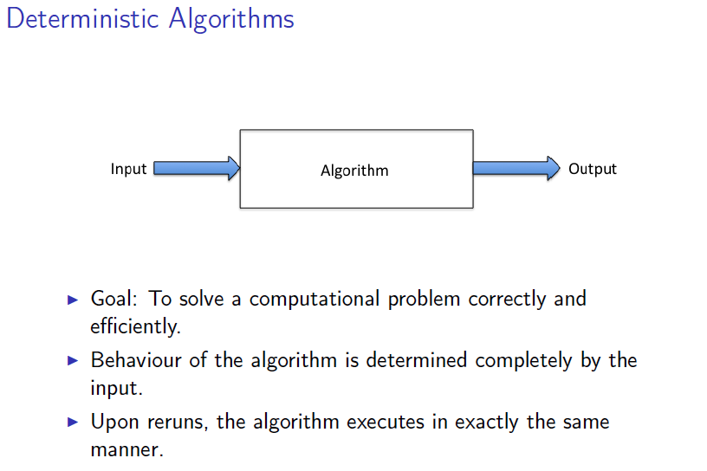

Slide 3
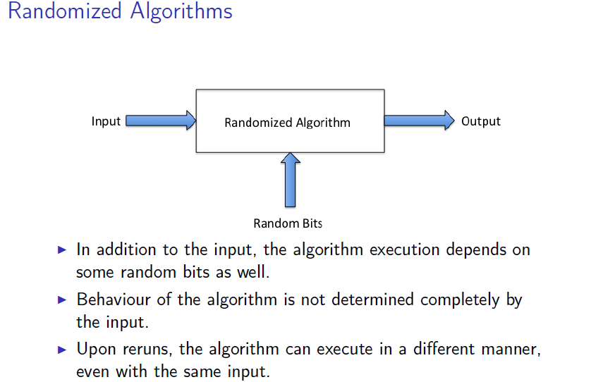

Slide 4
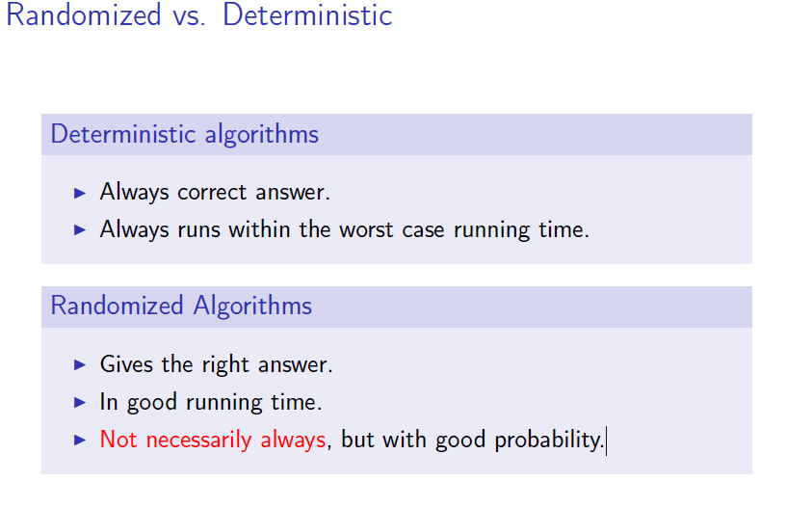

Slide 5
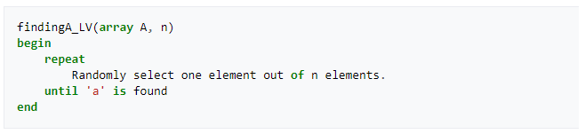
EXAMPLE
Input: An array of n≥2 elements, having a’s and b’s in it
Output: Find an ‘a’ in the array.

Slide 6
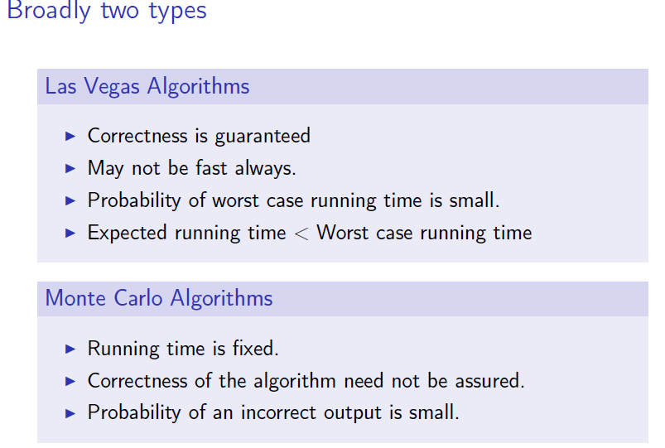

Slide 7
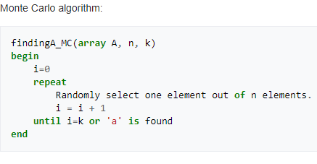
A simple Monte Carlo Method

Slide 8
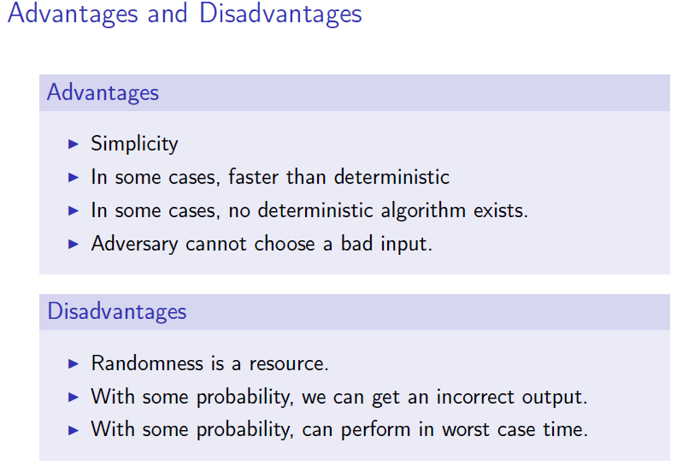

Slide 9
Probabilistic Analysis
Algorithm output/performance can vary depending on random bits.
Analysis will yield probabilistic statements.
For a random variable X, Pr(X = x) denotes the probability with which X takes the value x.
E(X) denotes the expectation of the random variable X.

Slide 10
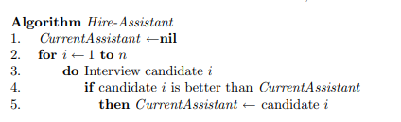
The hiring problem
If m people hired, total cost O(n c_{i} + m c_{h} ) (If c_{i} is small, can focus on (m c_{h} ) )
Worst-case?
Hire each person interviewed (they come in increasing order of quality); then total cost = n c_{h}
But reasonable to expect this will not happen. Yet we don’t know the order and we don’t have a control over that
What do we expect to happen in an average case?

Slide 11
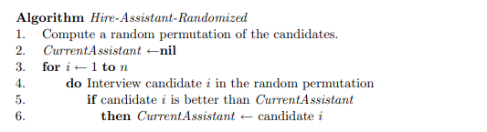


Slide 12
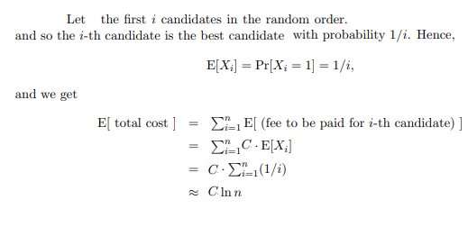

Slide 13
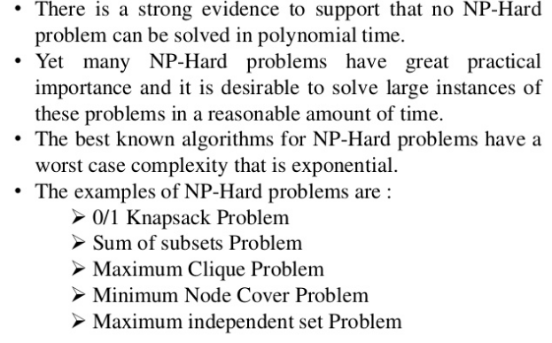
INTRODUCTION TO APPROXIMATION ALGORITHMS

Slide 14
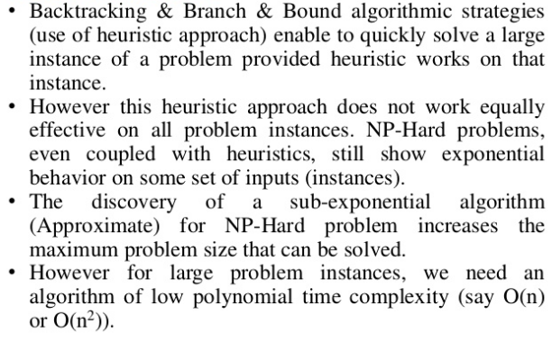

Slide 15
DEFINITION
Given an optimization problem P, an algorithm A is said to be an approximation algorithm for P, if for any given instance I, it returns an approximate solution, that is a feasible solution.

Slide 16
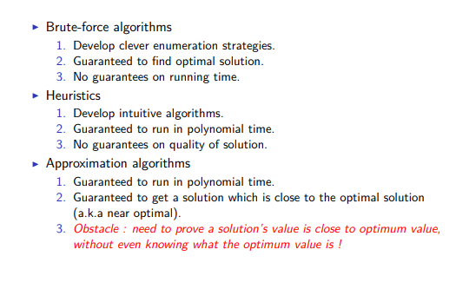
A COMPARISON

